Slide 1
MSBA Capstone Presentation
Pablo Zarate & Biva Sherchan

Slide 2

Team Introduction
Pablo Zarate
Senior Analyst in WFM Analytics at E-Trade
Formerly in Consumer Banking FP&A for Goldman Sachs
Well-versed in financial markets and macro-economy
Hi Biva! Thought a quick team introduction slide would be useful. My design idea would be image to the upper right and one on the lower left with some blurbs about us.
Happy to change if you want a different design choice as well ☺
Biva Sherchan
Vice President in xxx at Morgan Stanley
Formerly in Asset Management for Goldman Sachs
xxxx

Slide 3

Home Credit – Business Problem
Presentation Overview
Business Problem
Exploratory Data Analysis
Logistic Regression
Random Forest
GBM
Credit Lender for customers with bad or no credit history
Business Problem: Can we predict customers who will have difficulty paying back their loans?
Seeing as the Practice Presentation rubric wants us to get quickly to the analytical insights, I only had two ideas for a ‘Business Problem’ slide:
State business problem
Give overview of presentation layout

Slide 4
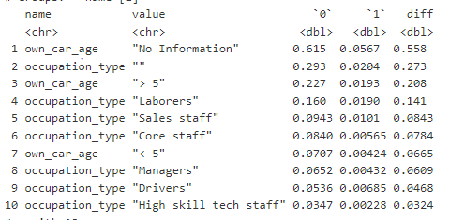
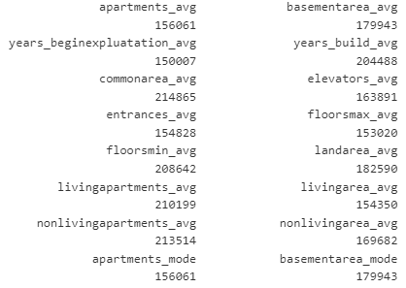
Exploratory Data Analysis
Dataset - application_train
Information of customer’s credit application
Binary ‘target’ variable with ‘1’ or ‘0’ values
1 = Has issues paying back loan
0 = No issues paying back loan
Cleaning the Data
Converted 23 integer/character variables to categorical
Deleted normalized housing information due to high number of NA values
Count of NA values by variable
Proportion of NA values with a ‘1’ target value
The ‘own_car_age’ and ‘occupation_type’ NA values have a higher proportion of ‘1’ target values - 5% and 2% respectively
This indicates predictive power
Modeling Challenge – how will we address NA values in our modeling?
Main points I highlighted for my EDA – happy to fix anything here.
Notes:
1. Converted 'character' variables to factor variables - as they are more memory efficient, better represents ordered relationships and will ensure that plots work as expected.

Slide 5
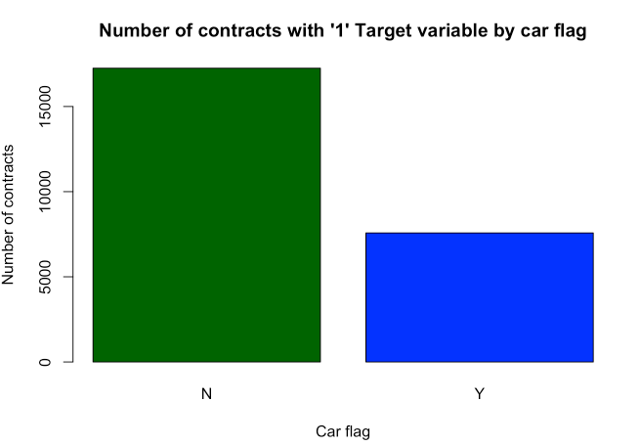
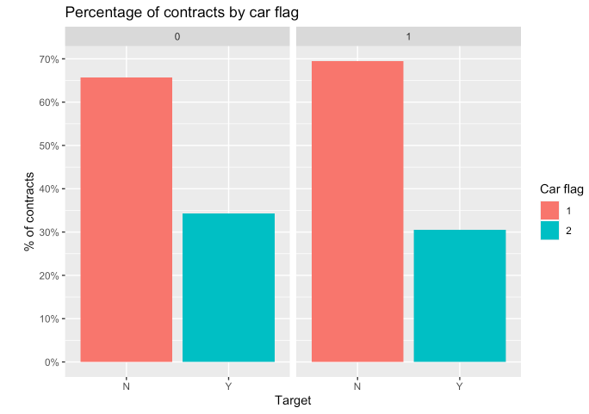
Exploratory Data Analysis – Car Ownership
Nearly 70% of clients in the target variable do not own a car.
Thought to give one of my EDA examples here

Slide 6
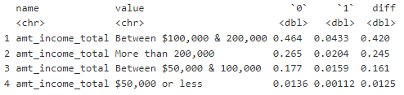
Exploratory Data Analysis – Summary Statistics
Will create dispersion chart here
Proportion of annual income by target variable
Half of this dataset has an annual income of between $100,000 and $200,000 at 50%
Majority of ‘1’ target variable makes between $100,000 and $200,000

Slide 7
Modeling – Logistic Regression
Issues
Cannot read NA or numerical values values
Text
Notes:
1. Converted 'character' variables to factor variables - as they are more memory efficient, better represents ordered relationships and will ensure that plots work as expected.

Slide 8
Modeling – Random Forest
Using name_education_type, _amt_credit, flag_own_car and amt_income variables
Initial ROC/AUC Comparisons
Cross Validation
Model Tuning
Final ROC/AUC Comparison
Will create visualizations for ROC/AUC
Notes:
1. Converted 'character' variables to factor variables - as they are more memory efficient, better represents ordered relationships and will ensure that plots work as expected.

